Slide 1
Rigid Body Equilibrium Analysis
Dr. Jacob Moore
Associate Professor of Engineering
Penn State Mont Alto

Slide 2
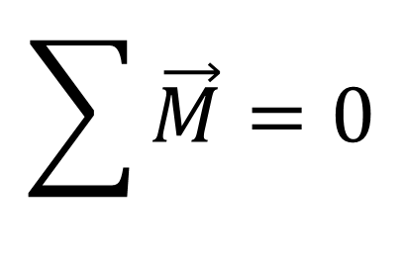
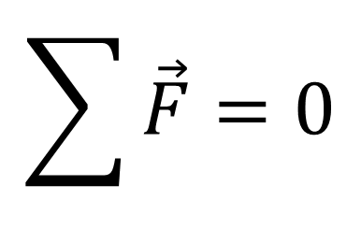
Rigid Body Equilibrium
A rigid body (unlike a particle) has the potential to have both linear acceleration (translation) and angular acceleration (rotation).
A body in equilibrium however is not accelerating in either fashion, therefore…
$$\sum{\vec{F}=0}$$
$$\sum{\vec{M}=0}$$

Slide 3
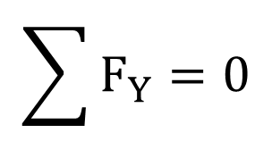
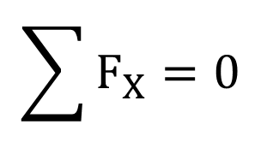
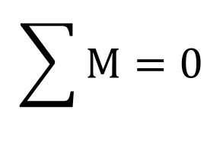
Rigid Body Equilibrium in 2D
$$\sum{F_{X}=0}$$
$$\sum{F_{Y}=0}$$
$$\sum{M=0}$$

Slide 4
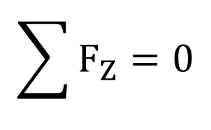
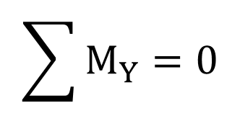
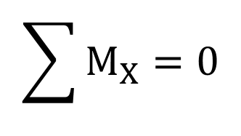
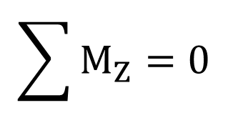
Static Equilibrium in 3D
$$\sum{F_{X}=0}$$
$$\sum{M_{X}=0}$$
$$\sum{F_{Y}=0}$$
$$\sum{M_{Y}=0}$$
$$\sum{F_{Z}=0}$$
$$\sum{M_{Z}=0}$$

Slide 5
Rigid Body Equilibrium in 2D
In two dimensions, the process for solving for unknown forces acting on bodies in equilibrium is as follows.
Draw a free body diagram of the body with all known forces, distances, and angles.
Write equilibrium equations for the sum of forces in the x and y directions.
Choose a point to take the moments about and take moments of all forces about that point.
Sum the moments about that point and set it equal to zero (for your moment equilibrium equation)
Solve the equations for unknown values.
This should give you three equilibrium equations and allow you to solve for up to three unknown forces per body.

Slide 6
Rigid Body Equilibrium in 3D
In three dimensions, the process for solving for the unknown forces is as follows.
Draw a free body diagram of the body with all known forces, distances, and angles.
Write equilibrium equations for the sum of forces in the x, y, and z directions.
Choose a point to take the moments about and take moments of all forces about that point
Use r x F calculations for moments if easier.
Add all the x components of the moment vectors and set them equal to zero. Repeat with the y and z components of the moment vectors (for your three moment equations).
Solve the equations for unknown values.
Use computer tools if necessary
This will give you up to six equilibrium equations and allow you to solve for up to six unknowns.

Slide 7
Thanks for Watching
See other engineering mechanics videos and access the full tool at…

Slide 8
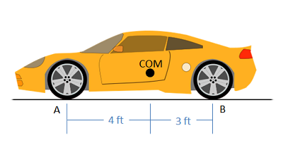
Rigid Body Equilibrium Worked Example
The car shown below has a weight of 1500 lbs and a center of mass as shown below. Determine the normal forces acting on the front and rear tires of the car.

Slide 9
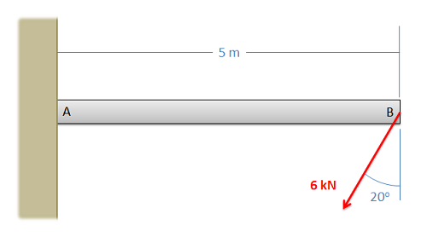
Rigid Body Equilibrium Worked Example
A cantilever beam as shown below is rigidly attached to the wall at A and a force acting at B as shown below. Assuming the weight of the beam is negligible, what are the reactions at A?

Slide 10
Rigid Body Equilibrium Practice Problem
Member ABC is 6 meters long with point B in the middle. Determine all forces acting on member ABC
45º
C
B
300 kg
45º
A

Slide 11
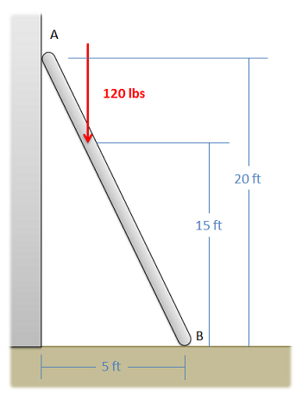
Rigid Body Equilibrium Worked Example
A ladder with negligible mass is supporting 120 lb person as shown below. If the contact point at A is frictionless, and the contact point at B is a rough surface, determine the forces acting at contact points A and B.

Slide 12
Rigid Body Equilibrium Practice Problem
While sitting in a chair, a person exerts the forces shown in the diagram. Determine the forces acting on the chair at points A and B. (Assume A is frictionless and B is a rough surface)
15 lbs
180 lbs
18 in
12 in
18 in
A
B
18 in

Slide 13
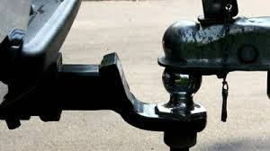
Rigid Body Equilibrium Worked Example
The trailer shown below consists of a deck with a weight of 250 lbs and an axel with wheels with a weight of 350 lbs. Assume the weight forces act in the center of each component. If we wish the tongue weight (F_{T}) of the unloaded trailer to be 50 lbs, how far from the front must we place the axel (d).
12 ft
d
F_{T}
F_{N}

Slide 14
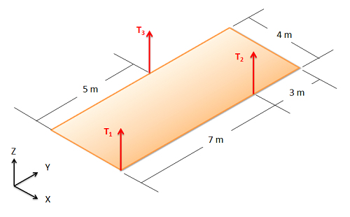
Rigid Body Equilibrium Worked Example
A 60 kg acoustic panel is supported by three cables as shown below. Assuming the mass in the panel is evenly distributed, what are the tensions in each of the cables

Slide 15
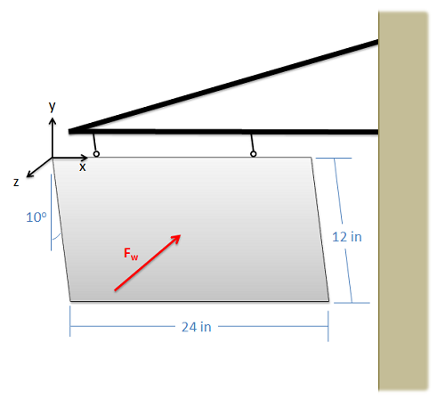
Rigid Body Equilibrium Worked Example
A 12” x 24” sign with a weight of 10 lbs hangs from two cables, each 6 inches from the side. The wind is pushing the sign such that it sits as a 10-degree angle. If we assume the wind can be modeled as a force acting in the center of the sign, what is the magnitude of the wind force?

